Slide 1
ONLINE LIBRARY MANAGEMENT SYSTEM

Slide 2
ABSTRACT
OBJECTIVE:
The aim of Library management system project is to develope a computerized system to maintain all the daily work of library.
It has a facility of admin login through which the admin can monitor the whole system.
Admin modules are insert book ,update book , delete book etc.
It has a facility of customer login also.
Customer modules are view list of books, purchase book etc.
Overall, this project is developed to help the library administration , maintain the library in the best way possible and reduce the human efforts.

Slide 3
MODULES OF ADMIN
INSERT BOOK
DELETE BOOK
UPDATE BOOK

Slide 4
MODULES OF CUSTOMER
VIEW LIST OF BOOK
PURCHASE BOOK
RETURN BOOK

Slide 5
LANGUAGE USED
FRONTEND LANGUAGE – Core Java
BACKEND LANGUAGE – MYSQL(Database)

Slide 6
SOFTWARE USED
JDK 8u221
Eclipse – jee-neon3
MySQL Workbench

Slide 7
DATA FLOW DIAGRAM
LOGIN
ADD NEW BOOK
VIEW BOOKS
Library Management System
ISSUE BOOK
RETURN BOOK
LOG OUT

Slide 8
USE CASE DIAGRAM
Use case diagram consist of use cases and actors and shows the interaction between them .The key points are:
The main purpose is to show the interaction between the use cases and the actor.
To represent the system requirement from user perspective.
The use cases are the function that are to be performed in the module.
An actor could be the end-user of the system or an external system.

Slide 9
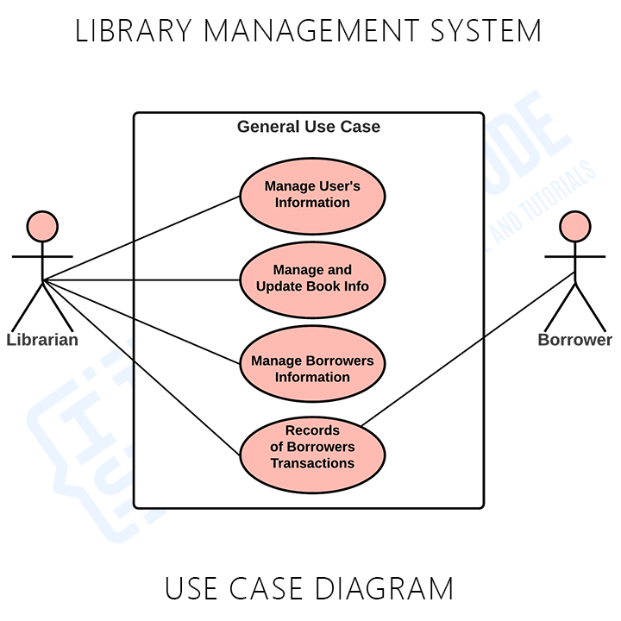
USE CASE DIAGRAM

Slide 10
CONCLUSION & FUTURE SCOPE
FUTURE SCOPE :
This application involve almost all the features of the online management . The future implementation will be online help for students and chatting with website administrator.
CONCLUSION :
The project entitled “Online Library Management” is developed using core Java as front end and MYSQL database in back end to computerize the process of online management . This project covers only the basic features required.

